Slide 1

Behaviour and Attitudes

Slide 2

Introduction
What is an Attitude?
Cognitive Consistency
Relationship between Attitude and Behaviour

Slide 3
What is an Attitude?
It exists in our mind and is about something, an ‘object’
They can be Explicit or Implicit
“Frank believes in women’s right to choose”
“Democracy is essential for global peace”
“I have no doubt that the earth is flat – just take a look at the horizon, for crying out loud!”

Slide 4
Components of Attitudes
Let’s Break it Down!
Cognitions
Evaluations
Behavioural Disposition

Slide 5
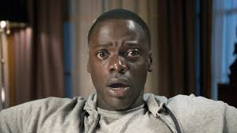
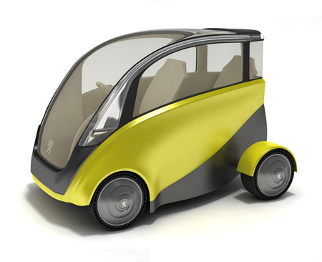
Components as Distinct
Affect-Based Attitudes
Cognition-Based Attitudes

Slide 6
Sources of Attitudes
Learned Through Socialization (Agents of Socialization – Family, Peers, School, Media)
Instrumental Conditioning
Classical Conditioning
Observational Learning

Slide 7

Instrumental (Operant) Conditioning
Punishment or Reinforcement are Used to Encourage or Discourse Behaviour
Four Types:
Positive Reinforcers
Negative Reinforcers
Positive Punishers
Negative Punishers

Slide 8





Classical Conditioning
Learning a new behaviour via association

Slide 9


Observational Learning

Slide 10
Cognitive Consistency
Consistency among our Cognitions
We Want Them Consistent

Slide 11

Cognitive Dissonance
Leon Festinger (1957)

Slide 12

Cognitive Dissonance
A State Where One or More Attitudes are Inconsistent with Our Cognitions
Dissonance After the Act
Dissonance When Act is Counter-Attitudinal

Slide 13
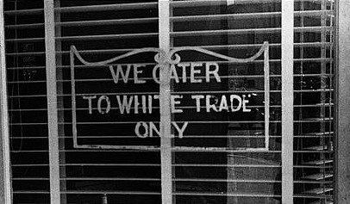
Do Attitudes Predict Behaviour?
LaPiere (1934)
Study on Discrimination Against Chinese People in America

Slide 14
Relationship Between Attitude and Behaviour
Affective-Cognitive Consistency
Relationship between the cognitive and affective (evaluative) components and behaviour
Significant consistency between the two is a strong predictor of behaviour
Situational Constraints
Behaviour determined by the situation and whether the people will respond negatively or positively

Slide 15
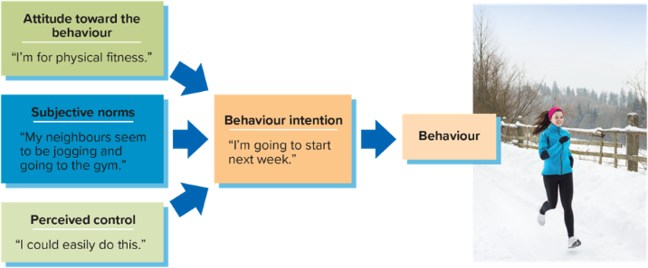
Theory of Planned Behaviour
Ajzen and Fishbein has shown that One’s (a) attitudes, (b) perceived social norms, and (c) feelings of control
Together determine one’s intentions, which guide behaviour

Slide 16

Do Behaviours Affect Attitudes?
Role-Playing and the Stanford Prison Experiment

Slide 17


Have a Great Day!

